Slide 1
OOPS THROUGH JAVAPROJECT
TIC TAC TOE GAME
Presented by :-
Madhu Kanneboina(227R1A0528)
Haroon Mohammad(227R1A0541)
P. Sharanya(227R1A0545)

Slide 2
Contents:-
Abstract
Introduction
Literature Survey
Hardware and Software requirements
Implementation
Result
Conclusion

Slide 3
Abstract:-
This presentation delves into the realm of programming with a focus on implementing a Tic Tac Toe game using Java. The abstract journey explores the core principles and coding techniques involved in creating a functional and interactive Tic Tac Toe experience.
From establishing the game's logic to leveraging Java's object-oriented capabilities for efficient design, this abstract provides a concise overview of the key components shaping the Java-based rendition of Tic Tac Toe.
Whether you're a Java enthusiast or a programming novice, this presentation offers insights into the art of transforming a classic game into a digital reality using the Java program.

Slide 4
Introduction:-
Welcome to the fascinating world of Tic Tac Toe, brought to life through programming! In this presentation, we will delve into the intricacies of designing and implementing a Tic Tac Toe game using code.
From the fundamental logic behind player moves to the graphical representation on the screen, join us on a journey through the creation of this classic and timeless game in the digital realm.
Whether you're a seasoned programmer or a curious beginner, this presentation aims to unravel the magic behind bringing Tic Tac Toe to your fingertips through the power of code. Let's embark on this coding adventure together!

Slide 5
Literature Survey
Tic-Tac-Toe is a straightforward but fun board game. The Tic-Tac-Toe game is learned using a variety of methods. Fok and Ong [3] and Grim et al. [4] For example, they developed strategies based on a neural network of artificial intelligence to play them.
Citrenbaum [5] and Yakowitz [6] discuss games like Tic- Tac-Toe, such as Go-Moku, Hex, and Bridg-It.
Traditionally, the Tic-tac-toe game is a pencil and paper game played by two people taking turns placing their pieces on the 3rd grid with the intention of becoming the first player to complete a horizontal, vertical, or diagonal line. Row with their pieces.
Many versions of the Tic Tac game software have been recorded, and have recently been made available on smart phones, including the Apple iPhone [7] and the Android environment [8].

Slide 6
Hardware And software Requirements
System requirements:
Operating system: windows xp or higher
Ide: Notepad and Jdk (any version)
Front end: windows
Language: Java
Hardware requirements:
Intel P4 1.5GHz or above
512MB RAM
80GB HDD Minimum

Slide 7
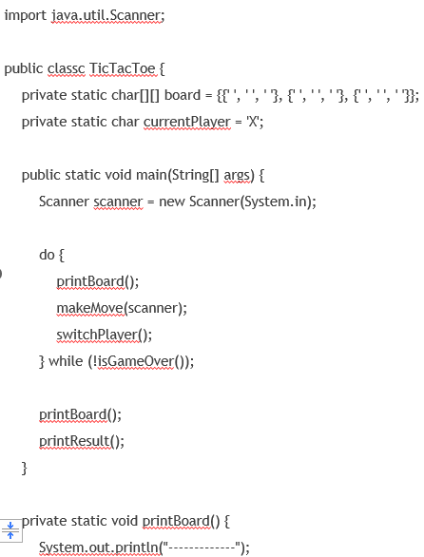
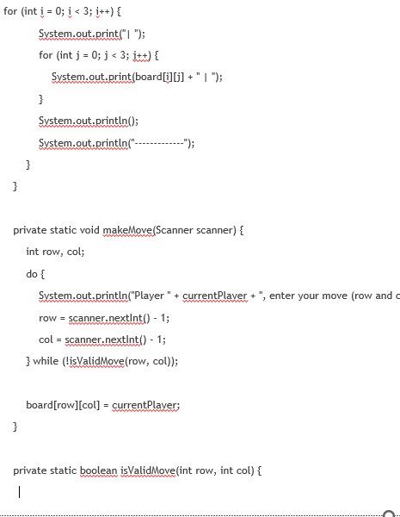
Implementation:-

Slide 8
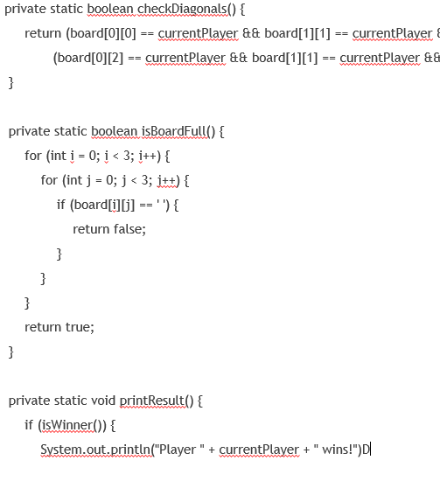
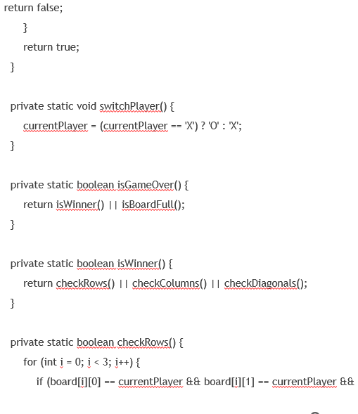

Slide 9
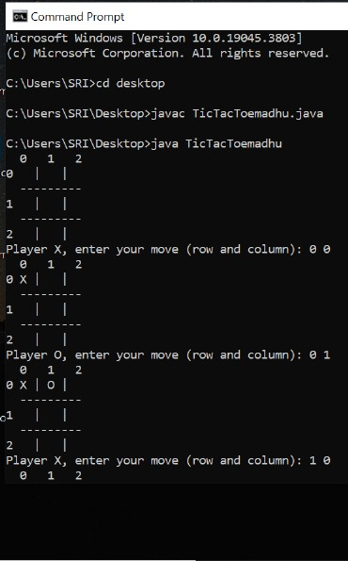
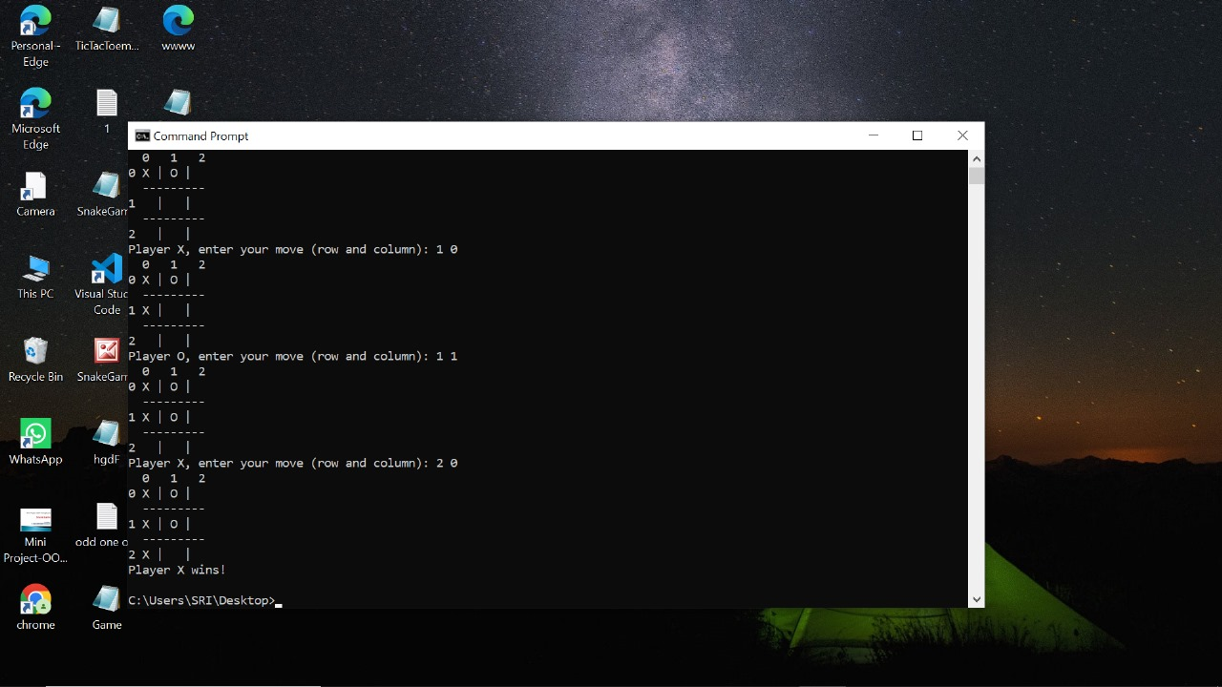
Result

Slide 10
Conclusion
We have built a Tic-Tac Toe using the Java programming language. Tic Tac Toe is a game that is played by people of all ages. It has been developed using the Java programming language. Any purpose-driven decision maker can have intelligence as a trait. A Tic Tac Toe algorithm has been presented in the system and tested, and it has proven to be effective. Chiefly, the system is free of errors.

Slide 11


